Slide 1
Airline Accessibility and Assistance Dogs
Presenter Name
Date and additional information

Slide 2
Agenda
The assistance dog industry & Assistance Dogs International
How service dogs help people with disabilities
General Standards of Behavior for Assistance Dogs
Americans with Disabilities Act vs. Air Carrier Access Act
Etiquette
Status of airline accessibility

Slide 3

Assistance Dog Industry
First guide dog school in the US opened in 1929
First service dog school in the US opened in 1975
First hearing dog symposium in 1985
ADI formally named in 1987
Public access test adopted in 1995
First non-English-speaking country hosts ADI conference in Spain in 2012

Slide 4
What is Assistance Dog International (ADI)
International coalition
Members representing service dog programs from across the world
Purpose is to improve the areas of selection, training, placement and utilization of service dogs.

Slide 5
What is the Mission of ADI?
To establish and promote standards of excellence in all areas of service dog acquisition, training and partnership. Facilitate communication and learning among member organizations and to educate the public to the benefits of service dogs and ADI membership.

Slide 6
What is ADI Accreditation?
Peer-review process for programs.
ADI voting member agencies can achieve compliance with the operational standards for training and placing service dogs.
ADI members must be accredited every 5 years.

Slide 7
What does it mean if a service dog is wearing an “Accredited by ADI” logo on his or her backpack or cape?
This service dog team was trained by an Accredited ADI member program that is recognized for upholding the highest standards of excellence in the training and placement of service dogs.

Slide 8
How service dogs help people

Slide 9
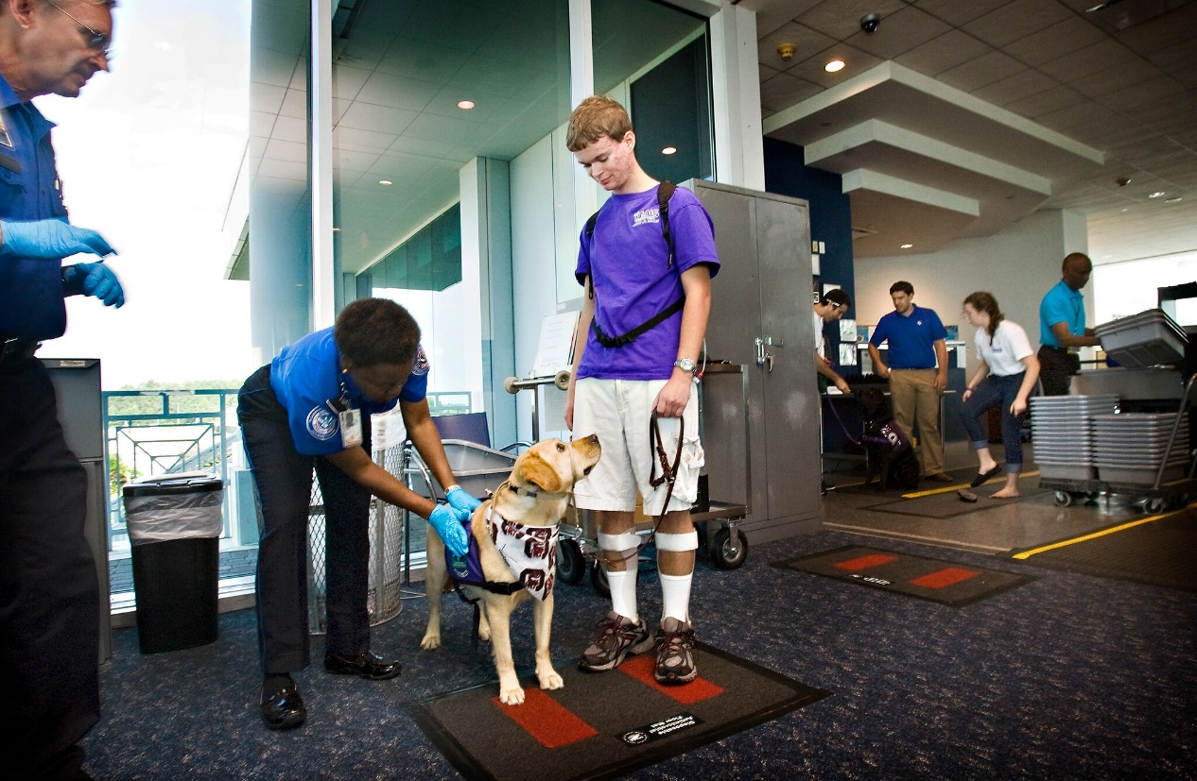
Hearing Dogs
Mobility Dogs
Guide Dogs
PTSD Dogs
Seizure Alert/Response Dogs
Balance Dogs
Diabetic Dogs
Combination/Specialty Dogs

Slide 10
Task Trained Service Dogs
Newest application of service dogs are helping people with psychological disabilities through tasks (PSA’s)
Anxiety interruption
Nightmare interruption
Position commands – front, behind
Light, retrieve, shake

Slide 11
Expectations of a trained service dog

Slide 12
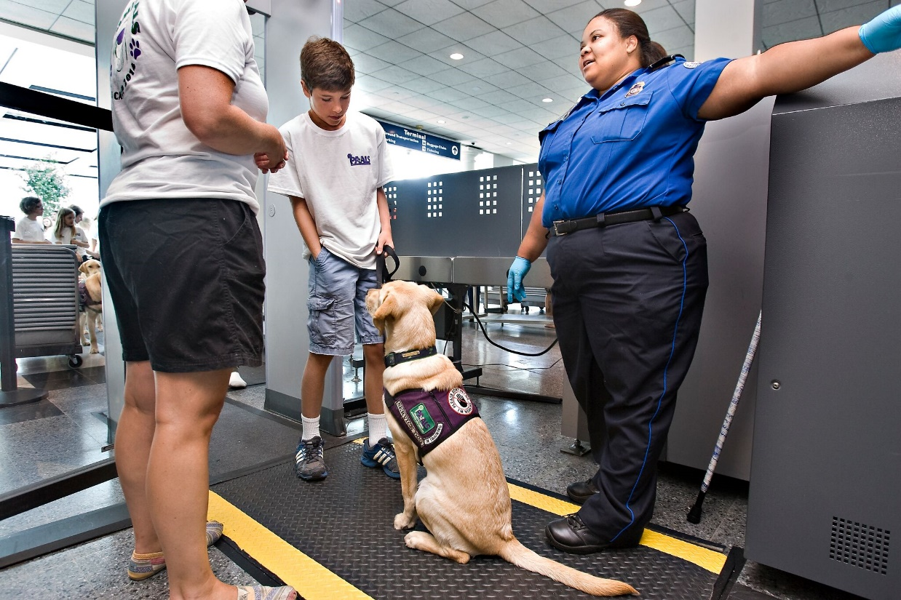
Service dog teams
Service dogs require years of training to learn specific tasks that directly mitigates the handler’s disability
Service dogs must be clean, in control and behave in a safe manner
Inappropriate behaviors for a service dog include
Aggression-Biting, snarling, growling, lunging
Uncontrolled barking
Some dogs use a trained bark to alert or get help
Eating off tables or floors
Interfering with other customers
Begging or interrupting
Jumping, lunging, aggression
Repeated toileting accidents
Notes:
Many people assume that there is no recourse against ill-behaved service and emotional support animals. However, the ADA and ACAA have behavior guidelines for any dog, service dog or pet. Any dog that is posing a safety threat (aggression) can be legally removed from the establishment. A service dog that is out of control (uncontrolled barking, interfering with other customers, wandering, etc.) can be legally removed if the owner has been given the opportunity to correct the behavior and the dog is continuing to behave inappropriately. Importantly, the handler must be permitted service without the presence of the dog.

Slide 13
What to Expect from a Service Dog Handler
Under the ADA, service dogs must be leashed, or tethered in a public space, unless these devices interfere with the service dog’s work or the individual’s disability prevents using these devices.
The individual must maintain control of the animal through voice, signal, or other effective controls.
With the exception of a safety issue (aggression), the handler has the right to remedy an inappropriate behavior and get their dog back under control
If the behavior continues, the dog may be excluded from the establishment. The handler must be allowed to use the establishment without the presence of the dog
Handlers are responsible for the health and cleanliness of the service dog
The handler does not need to have papers, ID cards/tags, doctors notes, special vests, etc. as there are no mandatory federal or state registries or certifications.

Slide 14
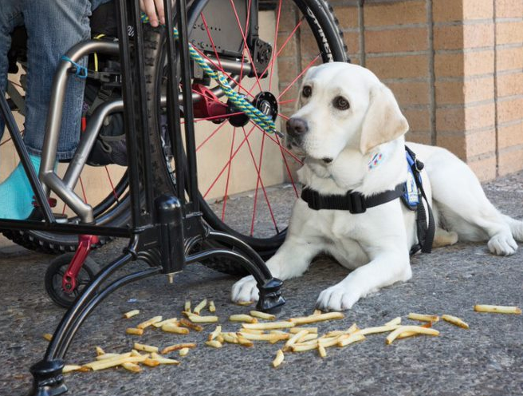

Examples of Behavior
Notes:
Service dogs should never forage for food. If the dog finds food, the handler is responsible for correcting the foraging behavior of their dog.

Slide 15
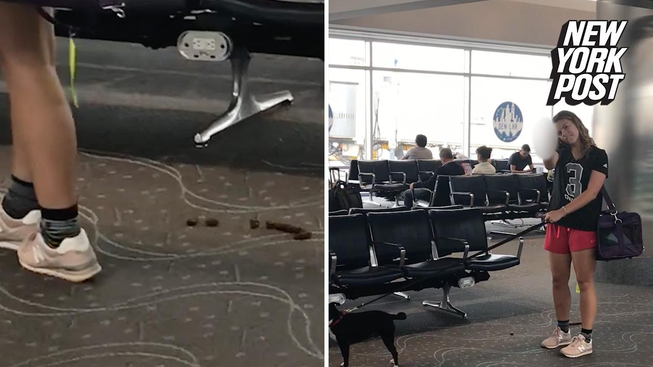
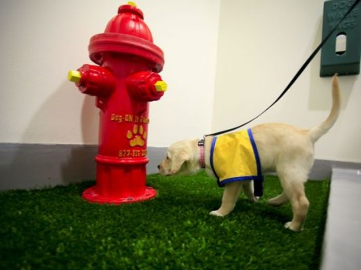
Examples of Behavior
Notes:
While accidents, particularly after a long flight, may happen, service dogs should be housebroken and the handler should prevent the dog from toileting in inappropriate areas.

Slide 16
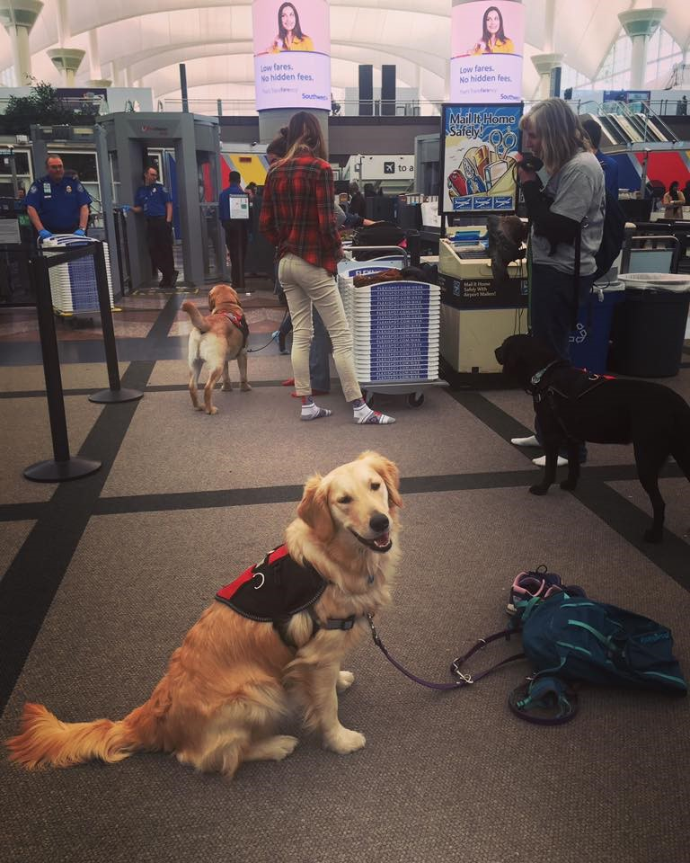

Examples of Behavior
Notes:
A service dog should never show aggressive behaviors. This includes snarling, lunging, snapping, biting, aggressive barking and growling.

Slide 17

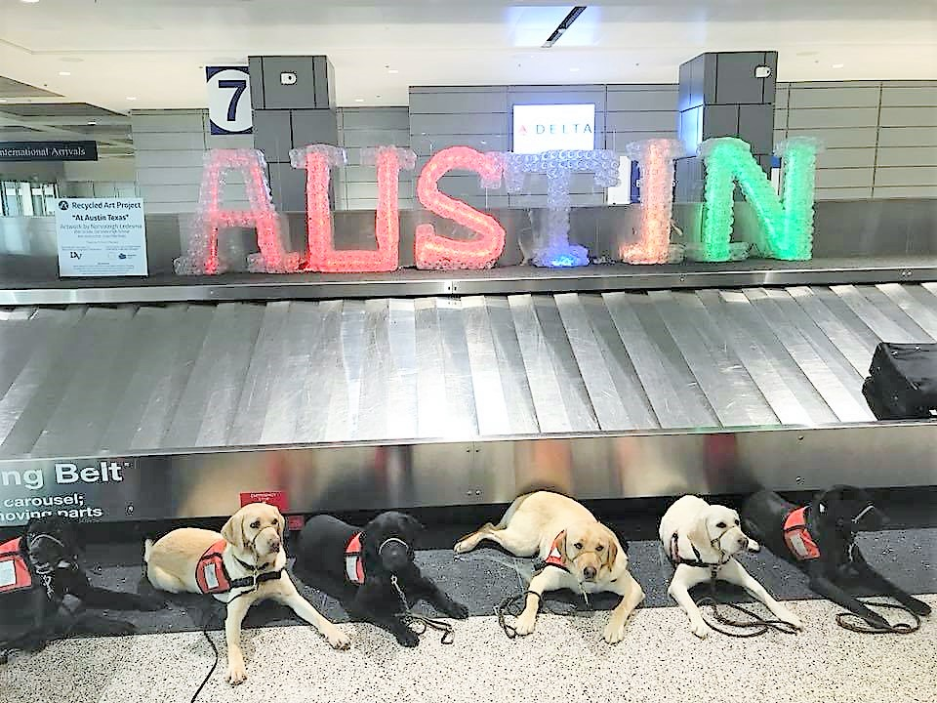
Examples of Behavior
Notes:
Service dogs are trained to walk calmly and in control next to their handler. They learn basic obedience including not forging on the leash as young puppies.

Slide 18
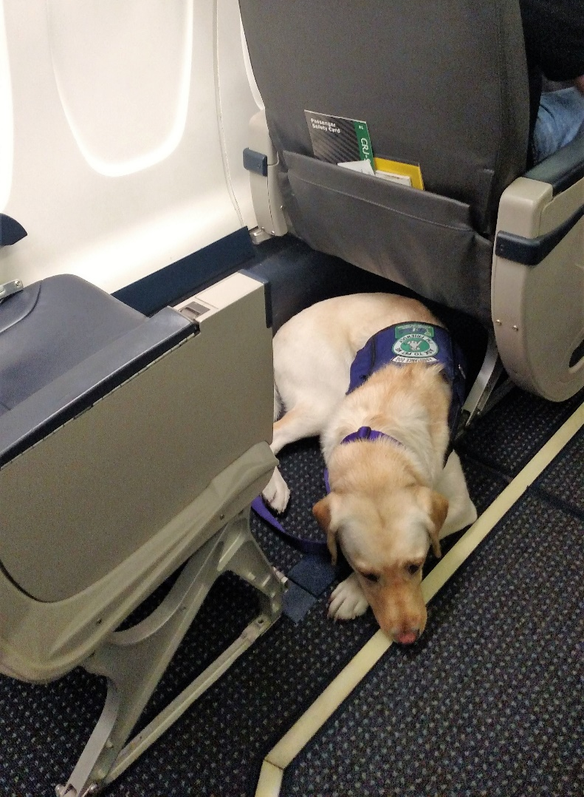
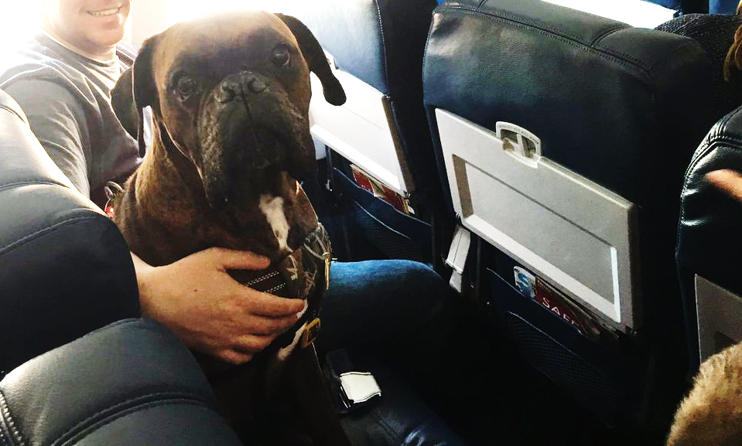
Examples of Behavior
Notes:
A service dog should remain on the floor of the airplane at all times unless being held on the lap of the passenger. ACAA guidelines only permit the dog to use the foot/seat space of the handler, not violating other passengers’ space. Dogs should never be on tray tables.

Slide 19
Air Carrier Access Act and Service Animals

Slide 20


Air Carrier Access Act (ACAA) and Service Animal Defined
Any animal that is individually trained or able to provide assistance to a qualified person with a disability; or any animal shown by documentation to be necessary for the emotional well-being of a passenger.
14 CFR Part 382
Notes:
Per the most recent statement from the ACAA on August 8th, 2019, there are no breed or size restrictions for service/ESA. Dangerous animals can be excluded from the cabin.

Slide 21
DOT’s Guidance Concerning Service Animals in Air Transportation
This guidance document “refine[d] DOT’s previous definition of service animal by making it clear that animals that assist persons with disabilities by providing emotional support qualify as service animals and ensure[d] that, in situations concerning emotional support animals, the authority of airline personnel to require documentation of the individual’s disability and the medical necessity of the passenger traveling with the animal is understood.”
Federal Register/Vol.68, No.90/May 9, 2003/Rules and Regs, p. 24875
14 CFR Part 382

Slide 22
DOT’s Guidance Concerning Service Animals in Air Transportation
This document was issued to “aid airline employees and people with disabilities in understanding and applying the ACAA with respect to service animals in determining: (1) Whether an animal is a service animal and its user is a qualified individual with a disability; (2) How to accommodate a qualified person with a disability with a service animal in the aircraft cabin; and (3) When a service animal legally can be refused carriage in the cabin.”
Federal Register/Vol.68, No.90/May 9, 2003/Rules and Regs, p. 24875
14 CFR Part 382

Slide 23
DOT’s Guidance – Continued
How Do I Know It’s a Service Animal and Not a Pet?
Similar to an animal that has been individually trained, the definition of a service animal (for purposes of the ACAA) includes:
An animal that has been shown to have the innate ability to assist a person with a disability; or an emotional support animal.

Slide 24
DOT’s Guidance – Continued
Two Steps for Airline Personnel
Establish whether the animal is a pet or a service animal, and whether the passenger is a qualified individual with a disability; and then
Determine if the service animal presents either
A “direct threat to the health or safety of others”, or
A significant threat of disruption to the airline service in the cabin (i.e. a “fundamental alteration” to passenger service).
See 382.7(c).
Notes:
1. This can be done using credible verbal assurance or by observation of the animal’s behavior.

Slide 25
Steps to determine whether an animal is a service animal or a pet
Step 1 – Obtain credible verbal assurances
Ask the passenger: “Is this your pet?” If the passenger responds that the animal is a service animal and not a pet, but uncertainty remains about the animal, appropriate follow-up questions would include:
“What tasks or functions does your animal perform for you”?
While remembering per the Guidance Document, “an animal used for emotional support need not have specific training for that function.”
“Would you describe how the animal performs this task
(or function) for you?”

Slide 26
Steps to determine whether an animal is a service animal or a pet
Step 1 – Obtain credible verbal assurances
If you believe the animal to be a pet, explain your airline’s policy on pets (i.e., will or will not accept for carriage in the cabin or cargo hold) and the procedures.
If the passenger does not accept your explanation, ask the passenger to wait while you immediately contact and consult with the Complaint Resolution Official.
The CRO normally has the authority to make the final decision regarding carriage of service animals.
Notes:
Service dogs, cats and horses are given priority under the newest DOT statement, as they are most common as service animals.

Slide 27
Steps to determine whether an animal is a service animal or a pet
Step 2 – Look for physical indicators on the animal, such as harnesses, vests, capes or backpacks.
Step 3 – Request documentation for service animals other than emotional support.
The law allows airline personnel to ask for documentation as a means of verifying that the animal is a service animal, but DOT urges carriers not to require documentation as a condition to travel with the service animal in the cabin unless a passenger’s verbal assurance is not credible.
Airline may require documentation such as a letter from a licensed professional treating the passenger’s condition (e.g., physician, mental health professional, vocational case manager, etc.)

Slide 28
Steps to determine whether an animal is a service animal or a pet
Step 4 – Require documentation for emotional support animals.
For emotional support that need not have specific training for the function, airline personnel may require current documentation (i.e., not more than one year old) on letterhead from a mental health professional stating
(1) that the passenger has a mental health-related disability;
(2) that having the animal accompany the passenger is necessary to the passenger’s mental health or treatment or to assist the passenger (with the disability); and
(3) that the individual providing the assessment of the passenger is a licensed mental health professional and the passenger is under his/her professional care.

Slide 29
Steps to determine whether an animal is a service animal or a pet
Step 5 – Observe behavior of the animals.
Service animals are trained to behave properly in public settings. An animal that engages in disruptive behavior shows that it has not been successfully trained to function as a service animal in public settings.
(But note: the ACAA does not require that Service Animals in Training be permitted to travel in the cabin because they do not yet meet the definition).

Slide 30
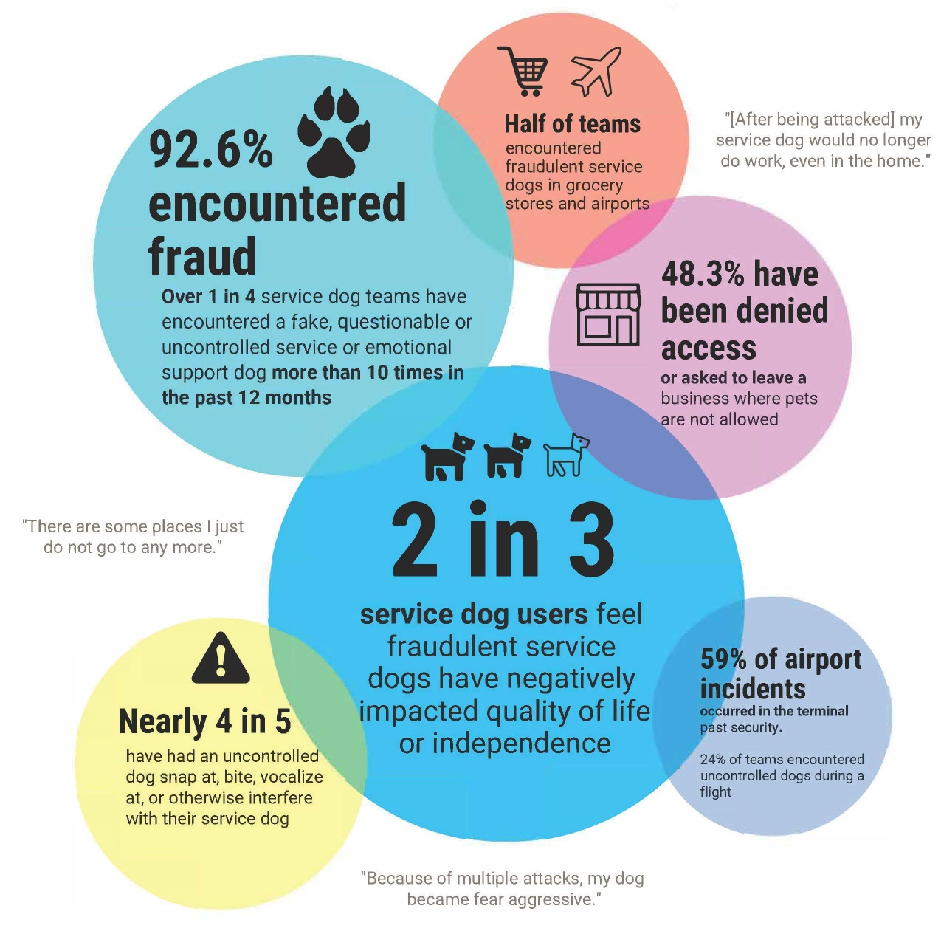
Service Dog User Survey
*2019 survey of 1,395 service, guide, hearing, medical alert, facility, and psychiatric service dog teams from 41 Assistance Dogs International accredited programs

Slide 31
Etiquette

Slide 32
Team Etiquette
When interacting with a person with a disability and assistance dog:
Introduce yourself and ignore the dog. Remain focused on the individual without interacting with the dog.
State what you are there for and ask how you can best assist the individual. Use phrases like: I am here to help you and your assistance dog, how do you need to be helped?
Ask individual is there anything they would like to share with you so you can be more aware of their body and space? i.e., Don’t grab me around the ribs – I hurt there.
Please do not grab the dog’s leash or talk to the dog.

Slide 33
Team Etiquette
Wait for permission from the individual on how best to handle the dog during transition. At that time, you may be asked to hold the leash.
Before leaving, ask if there is anything they can do to further assist them.
If the individual is traveling with an assistant (i.e., parent, interpreter, or other companion), please address both the individual and the assistant with the same level of attention, and follow any directions given by the assistant.

Slide 34
TSA and Service Animal Team Etiquette
The service animal’s equipment should never be removed during screening
The animal and passenger should never be separated during security screenings
If the person needs a pat down, the animal should be pat down, rather than handed to a companion or asked to go through screening without the handler holding the leash
Do not ask a wheelchair user to transfer out of their chair for screening
Ask the handler before patting down the animal so the handler can manage the animal effectively

Slide 35
Suggested Changes in Airline Accessibility
Align the ACAA with the ADA
Service dogs only dogs and miniature horses
Psychological service dogs categorized the same as task trained service and guide dogs

